Slide 1
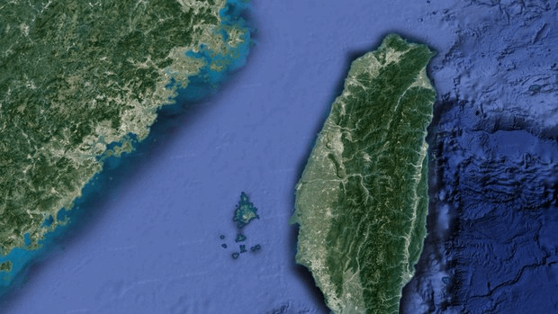
The Myth of a War in the Taiwan Strait Can Beijing, Taipei, and Washington Solve the Yizhou Dilemma?
Dennis Lu-Chung Weng
Sam Houston State University

Slide 2
Outline
Overview of “The Myth of a War in the Taiwan Strait”
How Do Scholars Interpret and Predict Cross-Strait Relations? Thucydides Trap V.S. Yizhou Dilemma
Assessment of Key Debates:
Status Descriptions
Cognitive Differences
Predictions
Why Elite Perception Matters? Comparing Assessments by High-level Elites from Three Sides:
Research Design: Elite Survey on Perceptions:
Empirical Results
Implication of the Yizhou Dilemma for Current International Conflicts

Slide 3
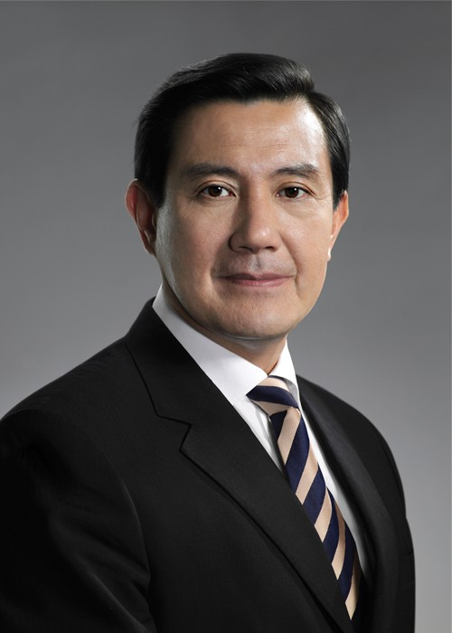


Three Prefaces
Dr. Ma Ying-Jeou
Former President of Republic of China (Taiwan)
Dr. JIA Qingguo
Key Member of National Committee of the Chinese People's Political Consultative Conference
Dr. Richard Bush
Former Chairman and managing director of the American Institute in Taiwan
Notes:
Jia: former Dean of the School of International Studies of Peking University
Bush: former chairman and managing director of the American Institute in Taiwan

Slide 4
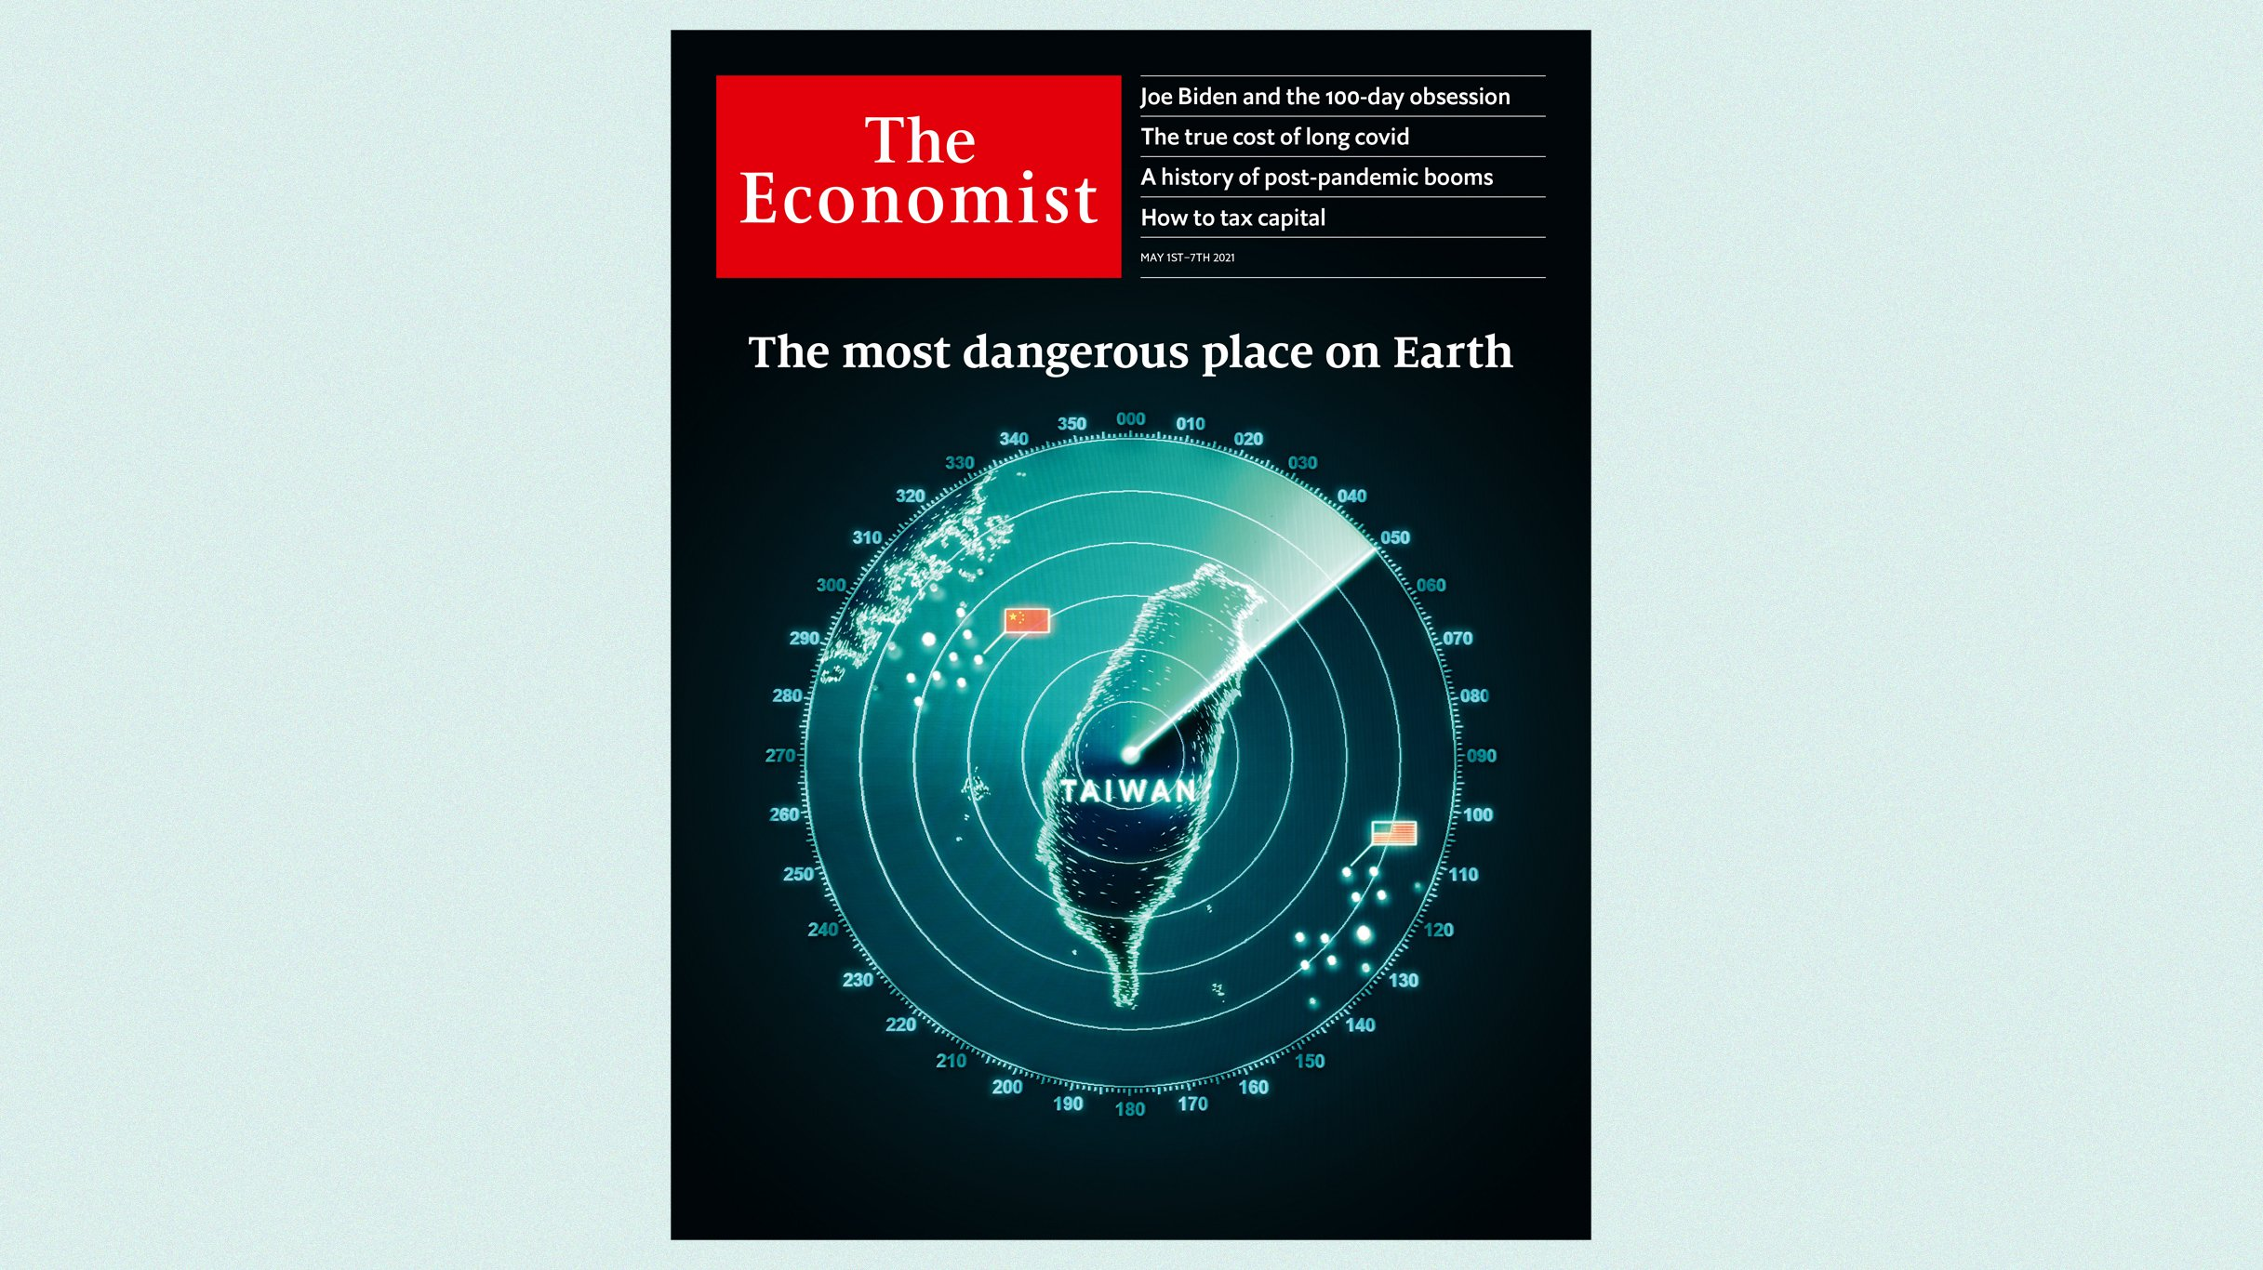
“So when we talk about the 2027 window [for an invasion of Taiwan], in my mind, that has to be a 2022 window or potentially a 2023 window.”
-- Adm. Michael Gilday (2022)
"Taiwan is clearly one of their ambitions. ... And I think the threat is manifest during this decade, in fact, in the next six years.“
-- Adm. Philip Davidson (2021)
Notes:
military leaders and political leaders such as the head of the U.S. Navy and the secretary of state have alerted the public claiming a “much faster timeline” to seize Taiwan, “as soon as by the end of 2022.”

Slide 5

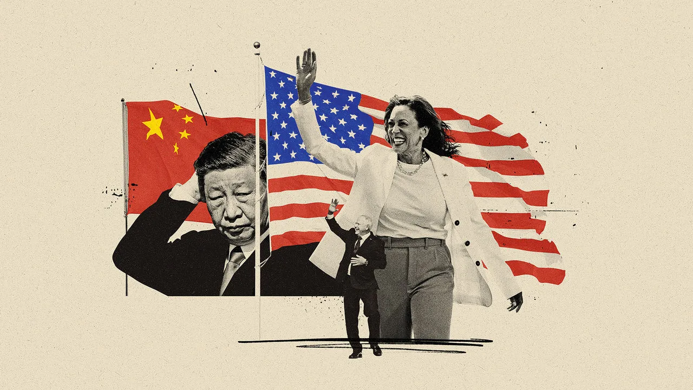
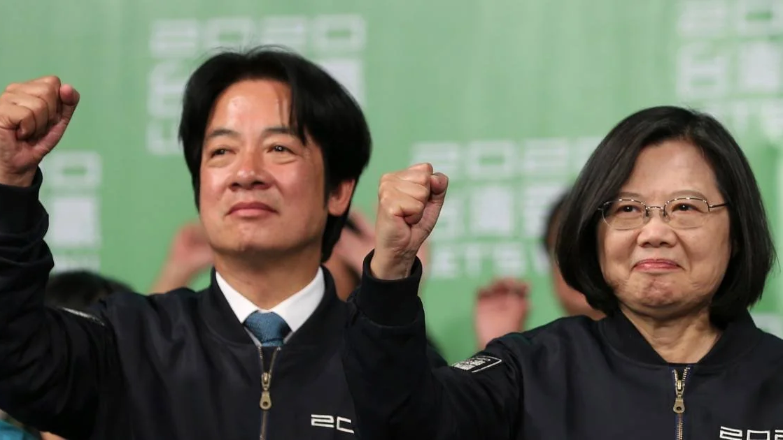
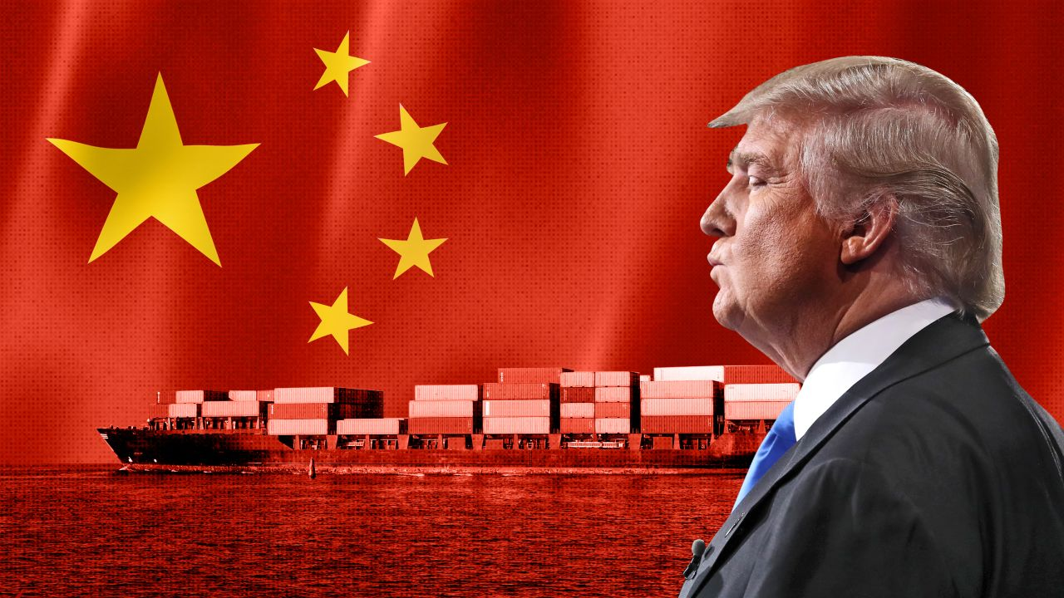

“The Myth of a War in the Taiwan Strait” Who’s Call?

Slide 6
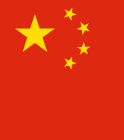
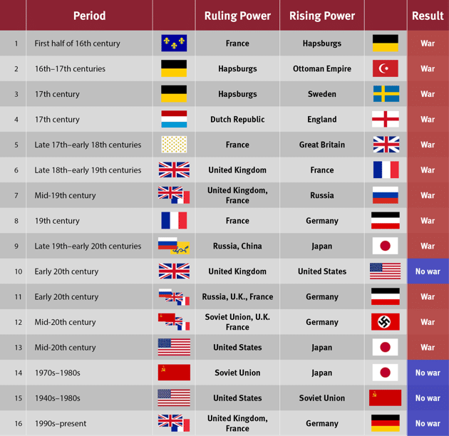
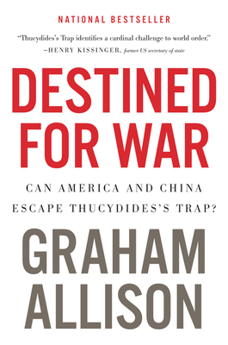

12 out of 16 = WAR
How Do Scholars Interpret and Predict Cross-Strait Relations? Thucydides Trap V.S. Yizhou Dilemma
Notes:
分析的时代在魏蜀吴三分天下之前的大约210年间（三国（狭义220年—280年，广义184年／190年／208年—280年）是中国历史一段三个国家并立的时期（237年—238年为四个国家并立时期））
魏（美），吴（俄），蜀（大陆），益州（台湾）
刘璋、刘备本是一家，同宗同源
益州内部：东州派（外省人）和益州派（本省人）➔ 曾有人提出了“一国两制”方案，及保持现状
魏吴之争（冷战）➔ 吴寻求蜀的帮助
刘备并不希望和曹操发生战争（正如中美的关系），但曹操对刘备的逐渐壮大存有戒心
益州困境：
蜀：想统一益州，但统一的过程不仅耗费军力财力，而且有损于刘备施仁政、德政的形象 ⬅影响软实力
但如果他满足于现状，不扩张，蜀国又有可能失去三大强国之一的地位，从而有可能阻碍其崛起。
益州：刘璋和他的益州也面临一个困境，因为与刘备闹翻不仅会导致其领地附近军事冲突加剧，而且他的政治和经济回旋空间也会缩小，更有可能被刘备的军队强行统一，占领整个西南地区。
然而，维持现状只会让刘备更加强大，因为包括益州精英在内的许多人通过互动与刘备建立更紧密的联系。维持现状会降低人们对刘备野心的警惕，并可能壮大潜在的威胁。
魏：魏国作为霸主，在目睹刘备的扩张并希望阻止蜀国崛起时也面临困境。魏国在东南战线上被吴国拖累太深，无法设法扭转局面并重新保持平衡。如果它忽视吴国的活动，其霸权地位可能不复存在。然而，首先对付吴国这个更迫在眉睫的威胁，意味着刘备和他的蜀国可以有更多的空间和时间去运作，并在以后挑战魏国的权力——从而不受制约地发起挑战。
备注：张鲁、马腾、士燮（xie,通谢）

Slide 7
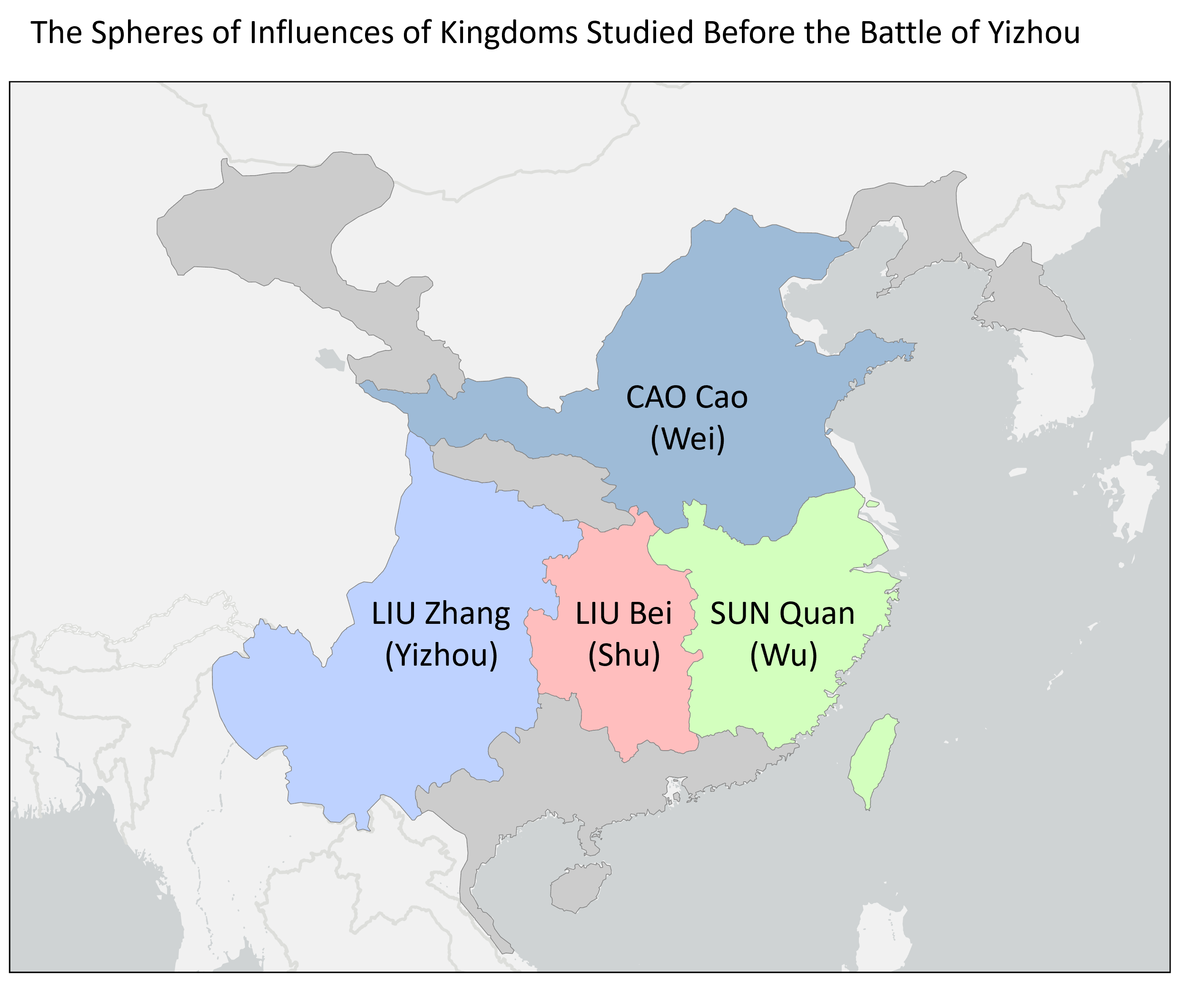
Introduction to “Yizhou Dilemma”
Notes:
分析的时代在魏蜀吴三分天下之前的大约210年间（三国（狭义220年—280年，广义184年／190年／208年—280年）是中国历史一段三个国家并立的时期（237年—238年为四个国家并立时期））
魏（美），吴（俄），蜀（大陆），益州（台湾）
刘璋、刘备本是一家，同宗同源
益州内部：东州派（外省人）和益州派（本省人）➔ 曾有人提出了“一国两制”方案，及保持现状
魏吴之争（冷战）➔ 吴寻求蜀的帮助
刘备并不希望和曹操发生战争（正如中美的关系），但曹操对刘备的逐渐壮大存有戒心
益州困境：
蜀：想统一益州，但统一的过程不仅耗费军力财力，而且有损于刘备施仁政、德政的形象 ⬅影响软实力
但如果他满足于现状，不扩张，蜀国又有可能失去三大强国之一的地位，从而有可能阻碍其崛起。
益州：刘璋和他的益州也面临一个困境，因为与刘备闹翻不仅会导致其领地附近军事冲突加剧，而且他的政治和经济回旋空间也会缩小，更有可能被刘备的军队强行统一，占领整个西南地区。
然而，维持现状只会让刘备更加强大，因为包括益州精英在内的许多人通过互动与刘备建立更紧密的联系。维持现状会降低人们对刘备野心的警惕，并可能壮大潜在的威胁。
魏：魏国作为霸主，在目睹刘备的扩张并希望阻止蜀国崛起时也面临困境。魏国在东南战线上被吴国拖累太深，无法设法扭转局面并重新保持平衡。如果它忽视吴国的活动，其霸权地位可能不复存在。然而，首先对付吴国这个更迫在眉睫的威胁，意味着刘备和他的蜀国可以有更多的空间和时间去运作，并在以后挑战魏国的权力——从而不受制约地发起挑战。
备注：张鲁、马腾、士燮（xie,通谢）

Slide 8
Dominating Power
Relatively Small, but influential State
Rising Power
Notes:
分析的时代在魏蜀吴三分天下之前的大约210年间（三国（狭义220年—280年，广义184年／190年／208年—280年）是中国历史一段三个国家并立的时期（237年—238年为四个国家并立时期））
魏（美），吴（俄），蜀（大陆），益州（台湾）
刘璋、刘备本是一家，同宗同源
益州内部：东州派（外省人）和益州派（本省人）➔ 曾有人提出了“一国两制”方案，及保持现状
魏吴之争（冷战）➔ 吴寻求蜀的帮助
刘备并不希望和曹操发生战争（正如中美的关系），但曹操对刘备的逐渐壮大存有戒心
益州困境：
蜀：想统一益州，但统一的过程不仅耗费军力财力，而且有损于刘备施仁政、德政的形象 ⬅影响软实力
但如果他满足于现状，不扩张，蜀国又有可能失去三大强国之一的地位，从而有可能阻碍其崛起。
益州：刘璋和他的益州也面临一个困境，因为与刘备闹翻不仅会导致其领地附近军事冲突加剧，而且他的政治和经济回旋空间也会缩小，更有可能被刘备的军队强行统一，占领整个西南地区。
然而，维持现状只会让刘备更加强大，因为包括益州精英在内的许多人通过互动与刘备建立更紧密的联系。维持现状会降低人们对刘备野心的警惕，并可能壮大潜在的威胁。
魏：魏国作为霸主，在目睹刘备的扩张并希望阻止蜀国崛起时也面临困境。魏国在东南战线上被吴国拖累太深，无法设法扭转局面并重新保持平衡。如果它忽视吴国的活动，其霸权地位可能不复存在。然而，首先对付吴国这个更迫在眉睫的威胁，意味着刘备和他的蜀国可以有更多的空间和时间去运作，并在以后挑战魏国的权力——从而不受制约地发起挑战。
备注：张鲁、马腾、士燮（xie,通谢）

Slide 9
Strategic Goal:
Control Yizhou to deter rising power from catching up and maintain the dominating status
Strategic Goal:
To Survive amid the power compeititon
Strategic Goal:
Takeover Yizhou to compete against dominating “Wei”
Notes:
分析的时代在魏蜀吴三分天下之前的大约210年间（三国（狭义220年—280年，广义184年／190年／208年—280年）是中国历史一段三个国家并立的时期（237年—238年为四个国家并立时期））
魏（美），吴（俄），蜀（大陆），益州（台湾）
刘璋、刘备本是一家，同宗同源
益州内部：东州派（外省人）和益州派（本省人）➔ 曾有人提出了“一国两制”方案，及保持现状
魏吴之争（冷战）➔ 吴寻求蜀的帮助
刘备并不希望和曹操发生战争（正如中美的关系），但曹操对刘备的逐渐壮大存有戒心
益州困境：
蜀：想统一益州，但统一的过程不仅耗费军力财力，而且有损于刘备施仁政、德政的形象 ⬅影响软实力
但如果他满足于现状，不扩张，蜀国又有可能失去三大强国之一的地位，从而有可能阻碍其崛起。
益州：刘璋和他的益州也面临一个困境，因为与刘备闹翻不仅会导致其领地附近军事冲突加剧，而且他的政治和经济回旋空间也会缩小，更有可能被刘备的军队强行统一，占领整个西南地区。
然而，维持现状只会让刘备更加强大，因为包括益州精英在内的许多人通过互动与刘备建立更紧密的联系。维持现状会降低人们对刘备野心的警惕，并可能壮大潜在的威胁。
魏：魏国作为霸主，在目睹刘备的扩张并希望阻止蜀国崛起时也面临困境。魏国在东南战线上被吴国拖累太深，无法设法扭转局面并重新保持平衡。如果它忽视吴国的活动，其霸权地位可能不复存在。然而，首先对付吴国这个更迫在眉睫的威胁，意味着刘备和他的蜀国可以有更多的空间和时间去运作，并在以后挑战魏国的权力——从而不受制约地发起挑战。
备注：张鲁、马腾、士燮（xie,通谢）

Slide 10
Challenge:
Domestic political polarization and competition
Challenge: Internal division between
Yizhou faction and Dongzhou Faction
Challenge:
Takeover Yizhou would be costly and it may cause internal collapse
Notes:
分析的时代在魏蜀吴三分天下之前的大约210年间（三国（狭义220年—280年，广义184年／190年／208年—280年）是中国历史一段三个国家并立的时期（237年—238年为四个国家并立时期））
魏（美），吴（俄），蜀（大陆），益州（台湾）
刘璋、刘备本是一家，同宗同源
益州内部：东州派（外省人）和益州派（本省人）➔ 曾有人提出了“一国两制”方案，及保持现状
魏吴之争（冷战）➔ 吴寻求蜀的帮助
刘备并不希望和曹操发生战争（正如中美的关系），但曹操对刘备的逐渐壮大存有戒心
益州困境：
蜀：想统一益州，但统一的过程不仅耗费军力财力，而且有损于刘备施仁政、德政的形象 ⬅影响软实力
但如果他满足于现状，不扩张，蜀国又有可能失去三大强国之一的地位，从而有可能阻碍其崛起。
益州：刘璋和他的益州也面临一个困境，因为与刘备闹翻不仅会导致其领地附近军事冲突加剧，而且他的政治和经济回旋空间也会缩小，更有可能被刘备的军队强行统一，占领整个西南地区。
然而，维持现状只会让刘备更加强大，因为包括益州精英在内的许多人通过互动与刘备建立更紧密的联系。维持现状会降低人们对刘备野心的警惕，并可能壮大潜在的威胁。
魏：魏国作为霸主，在目睹刘备的扩张并希望阻止蜀国崛起时也面临困境。魏国在东南战线上被吴国拖累太深，无法设法扭转局面并重新保持平衡。如果它忽视吴国的活动，其霸权地位可能不复存在。然而，首先对付吴国这个更迫在眉睫的威胁，意味着刘备和他的蜀国可以有更多的空间和时间去运作，并在以后挑战魏国的权力——从而不受制约地发起挑战。
备注：张鲁、马腾、士燮（xie,通谢）

Slide 11
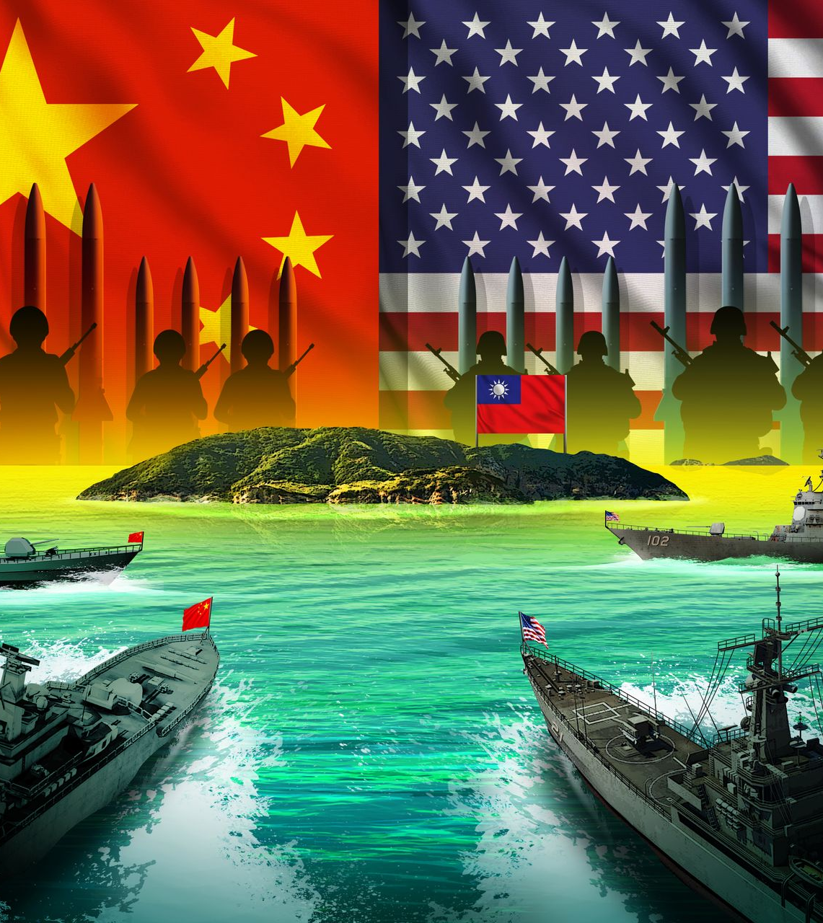
Assessment of key debates
Status descriptions
Cross-strait pessimism vs. a window of opportunity
On Taiwan’s democracy
On the U.S. foreign policy toward the Taiwan Strait
Cognitive differences
Armed conflict is not necessarily forced reunification
Issue-based approach vs. framework before details
Main causes of the current tension
Transparency vs. obscurity
Predictions
Is time on mainland China’s side?
Will the porcupine strategy work?
A war vs. a complex situation
Notes:
The individuals from the mainland think the U.S. assessment of the cross-strait balance to be static in terms of maintaining stability, while the U.S. interviewees specifically mentioned the macro idea of the status quo being vibrant and one cannot freeze East Asia in 1979.
On the other hand, the situation in 2023 is slightly better than the previous years. People in this camp have also observed that young people on the two sides share many common topics.
Tsai viewed as authoritarian
US use its political structure as excuses

Slide 12
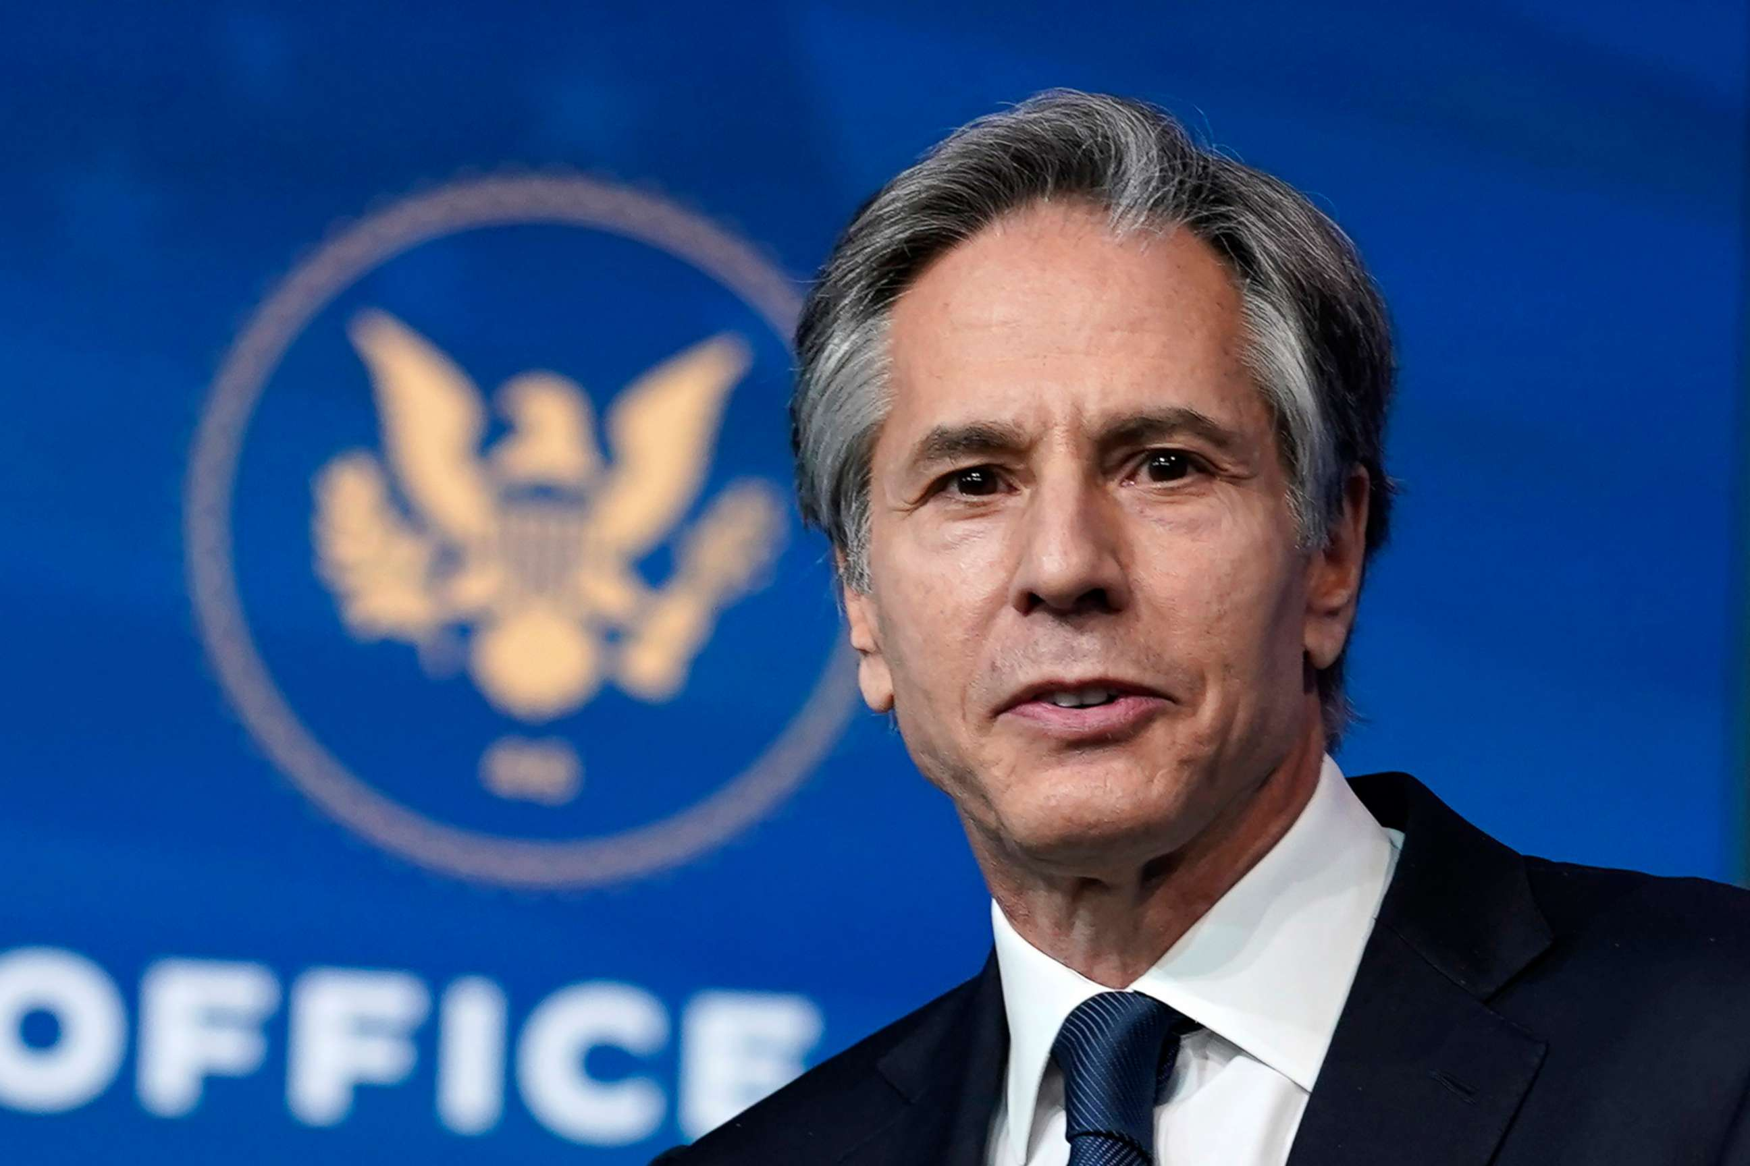
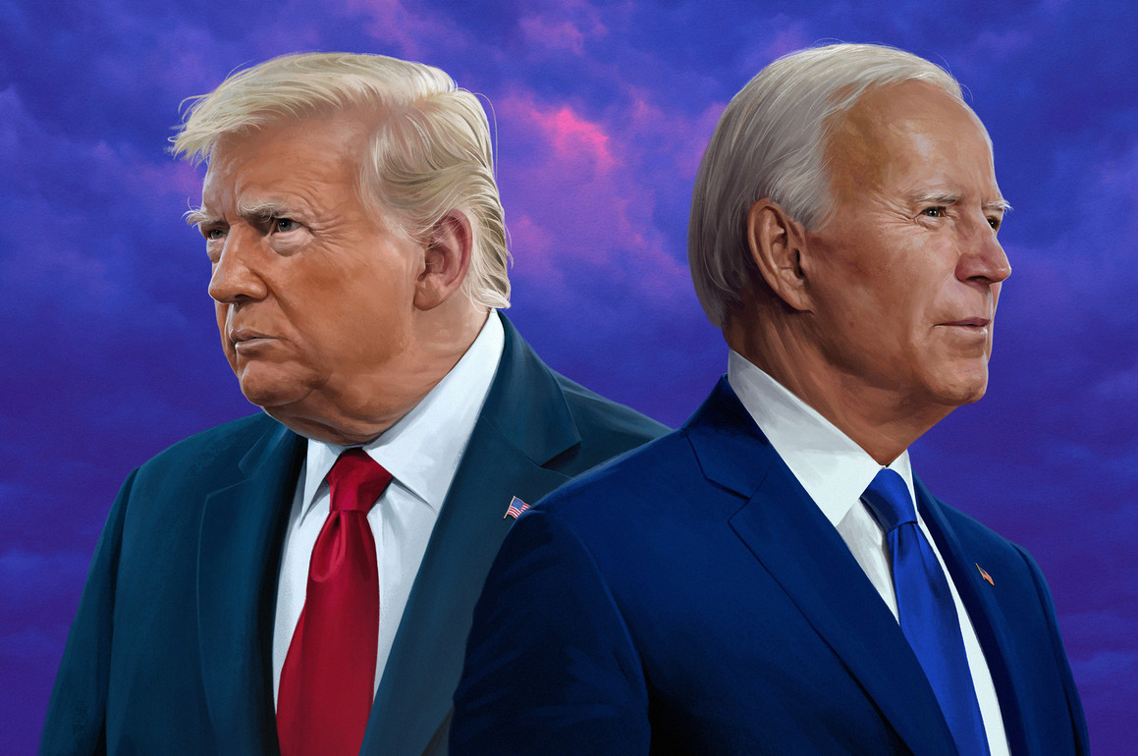
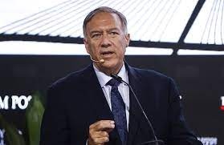
Inevitable War or The Myth of War? Who’s Call?
General Observation:
Both China and the U.S. are flexing their military muscles more and more. Meanwhile, Taiwan, is turning itself into a Porcupine….
But, General Public is not the decision maker…..

Slide 13
Comparing the assessments by the highest-level elites from the three sides
Their evaluation of the possibility of war in the Taiwan Strait in the next decade;
Their self-perceptions, perceptions of the other two parties, and the three sets of bilateral relations, as well as core misperceptions and disputed assessments;
Main turning points in the past and likely scenarios in the future.

Slide 14
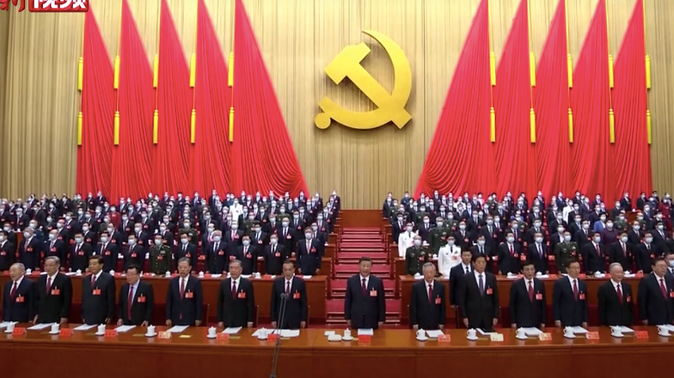
Assessment by the Highest-Level Elites
from Mainland China

Slide 15

Beijing Elites’ evaluation of the possibility of war in the Taiwan Strait in the next decade
Peaceful unification is still the priority
Not likely in the short run
Can act tougher when a third party intervenes, but large-scale kinetic wars should be resolutely avoided (坚决避免).
The U.S. has extensive experience preventing a cold war from sliding into hot wars
Pre-emptive strikes against U.S. forces or bases in East Asia would not be a viable option
Integrated development by the two sides (两岸融合发展) for the next decade
Make friends with neighbors
Maintaining the status quo depends on sound Sino-U.S. relations
The U.S. executive and legislative branches’ actions are factors
Notes:
Hot war is unlikely; cold war is possible
Just like Chairman Mao famously said, “only attack Chiang [Kai-shek] ships, never attack American ships,” after all, Beijing still sees the Taiwan Strait question as a domestic matter.
Quote Deng Xiaoping: when you strive for a peaceful and friendly surrounding environment, Taiwan will not be able to move away.”
Terminal High Altitude Area Defense (THAAD)

Slide 16

Factors that could lead to war – Beijing Elites’ Perspective
Visits by high-level officials, Taiwan processing nuclear weapons or THAAD, or joining the UN as a sovereign member
From the 2005 Anti-Secession Law: Taiwan formally declaring independence or having an independence referendum
Admitting “completely exhausting all peaceful means for reunification” is a bit vague, but the vagueness benefits Beijing (reserving the right to final interpretation). ➔ there is no timetable, as a timetable would put Beijing in a difficult position.
Notes:
Hot war is unlikely; cold war is possible
Just like Chairman Mao famously said, “only attack Chiang [Kai-shek] ships, never attack American ships,” after all, Beijing still sees the Taiwan Strait question as a domestic matter.
Quote Deng Xiaoping: when you strive for a peaceful and friendly surrounding environment, Taiwan will not be able to move away.”
Terminal High Altitude Area Defense (THAAD)

Slide 17

Beijing Elites’ perceptions and misperceptions
Pessimistic as long as the DPP is in charge (DPP is promoting cultural independence first)
Lai is calculative and changes his stance when needed
Previous supportive gestures toward Taiwan were ignored
Believe Taiwanese voters have the highest personal quality in Asia and are pragmatic and difficult to be fooled
Believe it is most convenient for the U.S. to play the Taiwan card
In the past, the U.S. congress was a participant in crisis management endeavors; nowadays, it is exceptionally provocative
Answering the call from the hotline is conditional (if there were previous warnings, like the Pelosi visit, and the visit still took place, the U.S. should not expect the phone would be picked up, at least not immediately)
Notes:
“As long as the DPP is in charge and because its party’s 1991 charter calls for the creation of a ‘Republic of Taiwan’ and a new constitution, conflicts could be triggered at any moment with a move towards the DPP’s stated goal.”

Slide 18

Beijing Elites anticipation of the future
Scenario #1: an upgraded version of the 1995-96 crisis
Scenario #2: Attack ROC territories other than Taiwan
Scenario #3: Retaliatory military operations
Scenario #4: Small-scale trade conflicts
Scenario #5: Maintain the status quo and low-level communications
不能打，不愿打，必要的时候就得打 （as for war, we cannot fight and are unwilling to fight, but must fight when necessary.）
Notes:
No discussion about peaceful unification or unification by force, as they see neither to be likely during the next decade.

Slide 19
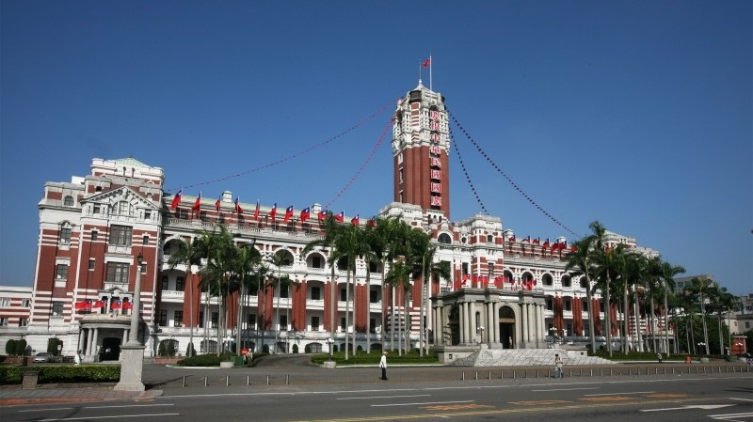
Assessment by the Highest-Level Elites
from Taiwan

Slide 20
Taipei Elites’ evaluation of the possibility of war in the Taiwan Strait in the next decade
Beijing's Dual Strategy Toward Taiwan
- Focus on peaceful integration through business and civil society.
- Deliberately excludes pro-independence factions from key exchanges.
- Seeks to suppress independence movements while maintaining economic cooperation
Concerns of Taipei Experts
- Experts emphasize the importance of vigilance in countering potential shifts in Beijing’s approach.
- Growing urgency to develop a comprehensive response to Beijing's multi-layered strategy.

Slide 21
Taipei Elites’ evaluation of the possibility of war in the Taiwan Strait in the next decade
Possibility of Escalation
- Current strategies favor peace, but global instability and China's domestic pressures could lead to more aggressive tactics.
- Taiwan’s strategic window for effective action is narrowing, with increasing reliance on the U.S. potentially reducing its autonomy.

Slide 22
Taipei Elites’ perceptions and misperceptions
Partisan Divide in Cross-Strait Strategies
DPP (Democratic Progressive Party):
Success seen in Tsai Ing-wen's cautious diplomacy, with U.S. backing.
The US-Taiwan relation is strong enough to move forward, so it’s time to try to advocates for a "One China, One Taiwan" stance, challenging Beijing’s view.
Opposition Parties (KMT):
Favor maintaining the "92 Consensus" for stable Cross-Strait dialogue.
Support deterrence to reinforce Taiwan's autonomy while engaging Beijing in negotiations. – KMT reformers, not all
Divergent Views on Deterrence
DPP:
Deterrence as a tool to resist unification under Beijing's terms.
Focus on presenting symbolic strength with little understanding about comprehensive defense
Opposition (KMT):
Deterrence as a means to maintain the "Republic of China on Taiwan" and engage in dialogue from a position of strength.

Slide 23
Taipei Elites anticipation of the future
Communication Gaps with Beijing
- Absence of direct dialogue increases risks of miscalculation.
- Reliance on indirect communication (via Washington) is inadequate, especially during crises (e.g., the "Missile Alert" incident). Semiconductor Industry Concerns
- Pressure to relocate manufacturing to the U.S. creates economic challenges.
- Fear that political decisions might undermine Taiwan’s "Silicon Shield" without securing adequate returns or protections.
- Debate over balancing economic interests with geopolitical realities.
Strategic Balancing Act
DPP:
Taiwan should lean closer to the US as Beijing will never sincerely respect Taiwan
KMT
Taiwan must navigate its position between Washington and Beijing carefully.
NOTE: Both DPP and KMT stress the importance of U.S. understanding Taiwan’s nuanced defense strategies and the necessity of dialogue with Beijing.

Slide 24
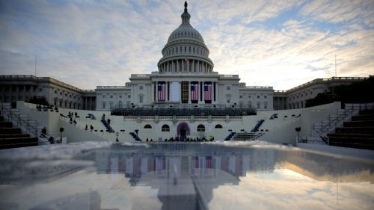
Assessment by the Highest-Level Elites
from the U.S.

Slide 25
DC Elites’ evaluation of the possibility of war in the Taiwan Strait in the next decade
The U.S. will not provoke other sides to cause war; if there is a war, it will be caused by Beijing
War is unlikely before 2035
Skirmish or small-scale military conflict, cold or chilly peace, combined with full-scale economic and trade conflict, and potential peaceful reunification with cross-strait integration might be the more possible outcomes
If there is a kinetic conflict, the U.S. response might depend on how the conflict started.
If Taiwan unilaterally challenges mainland China’s fundamental interests, such as declaring independence outright, the U.S. will not intervene
if the PRC unilaterally attacks Taiwan and the ROC military has increased its military deterrence capability, the U.S. will intervene. Most likely the “Ukraine Model.”
Peaceful unification is possible, but not due to PRC’s successful use of the “one country, two systems” approach, but through “coercion without violence.”
Very unlikely for the ROC to declare de jure independence

Slide 26
DC Elites’ perceptions and misperceptions
Worried about PRC’s rapid military build-up and lack of clarity ➔ the PRC has injected stress into the bilateral relations
PRC should not assume that the U.S. will have absolute influence over its treaty allies in the Indo-Pacific (they are not puppets of the U.S.)
The U.S. would not ask Chinese ships to leave if they were in the U.S. Exclusive Economic Zones (EEZ). The U.S. respects the rule-based international order and demands China to do so.
Washington elites did not believe the U.S. would be provocative to cause a war.
The PRC has an echo chamber problem
Washington elites object to using “containment” in describing the U.S. approach towards the PRC. It is a competition in which competitors try to perform their best, and every participant can improve after such competition.
The U.S. “One-China Policy” does not negate the possibility of one China and, therefore, includes the “One China Principle” advocated by Beijing. On the other hand, the U.S.'s involvement in defending Taiwan has always been on the table but should not be seen as absolute or be treated as a blanket statement.
They cautioned that Beijing should be careful to assume that the KMT is the good side and the DPP is the bad side for them.
Notes:
key information and signaling from the outside may not reach the top decision-makers or might be delayed
When discussing this policy, Washington elites explain that it is necessary to distinguish four aspects. The first aspect is about Taiwan’s legal status. Nothing has changed, and it is still that “the U.S. acknowledges the Chinese position,” as stated in the three Communiqués. The U.S. still emphasizes the choice of the word “acknowledge,” arguing that the U.S. does not see such positions to be its own – in fact, it is still to be determined.
The second aspect is the basic structure of the U.S. – Taiwan relations. Again, nothing has changed. The U.S. does not have an embassy or an ambassador in Taipei and still only has the American Institute in Taiwan (AIT). The same is true for Taiwan’s presence in the U.S. Such informal, unofficial relationships will be maintained.
The third aspect is the actual conduct of that relationship. That clearly has evolved over time. Certainly, after 1994, it has occurred often as the U.S. has understood that circumstances have required different approaches to the U.S. conduct of Taiwan relations. The U.S. realized it was now in its interest to have good communication with Taiwan’s military for training—before that, it was just arms sales. This evolution of the relationship aimed to boost Taiwan’s confidence in the face of coercion without violence.
The fourth and final aspect is the broad consideration of the U.S. policy. There is no doubt that the U.S. policy has shifted. The PRC’s military buildup, which started in 1998-99, certainly fostered the change of conduct of U.S. policy. In the late 1990s, the U.S. recognized and articulated its understanding that Taiwan’s democratization was a new factor in cross-strait relations. Thus, it was not solely due to U.S. policy change; Taiwan has also shifted.

Slide 27
DC Elites anticipation of the future
War is still possible, but the two sides might be able to work out a communication strategy that can be counted on when emergencies happen
Even if wars happen, they are unlikely to escalate to nuclear wars.
Taiwan’s de jure independence is most likely to occur when Taiwan’s leaders underestimate Beijing’s resolve and overestimate the potential U.S. support.
Beijing’s policy adjustments after the 2024 Taiwan election will probably be minor. Beijing will continue with its low-risk strategy of “coercion without violence” as there are signs that it is working.
A feasible peaceful plan should outline a framework for power-sharing between the CCP and the multiple parties in the ROC.
But the authorities in Beijing might need to tame the rising nationalism in mainland China; otherwise, it would be difficult for leaders to respond appropriately and propose peaceful solutions that could be viable to all parties
A peaceful resolution is still acceptable to the U.S. if the resolution is military-free and coercion-free.
If one only defines “peaceful” as “non-violent,” it does not work. It has to be truly peaceful without coercion.
As soon as you open the door to war, you lose immense control. One might not be able to return to the original state before the door was opened.

Slide 28

Research Method and Data
Comparative analysis: Elite Survey Methodology
Elite opinions (Specialized Survey and interviews)
Data Collection
Elites from mainland China, Taiwan, the U.S., and ethnic Chinese globally
169 elite surveys: 2021/8 ~ 2024/5 (175 before clean)
Note: In addition to elite surveys, 109 elite Interviews and participant observations of closed-door monthly Taiwan-focused discussions: 2021/3 ~2023/5

Slide 29
Research Method and Data: Note
Party identification question: Can’t apply in China
In order to suit the specific complexities within the Chinese Communist Party. We used questions gauging attitudes toward historical projects like the Three Gorges Dam as a proxy for ideological positioning.
Does demographic factors influence the results?
Those completed the survey were born between 1934 to 1992, with a mean birth year of 1969 and a standard deviation of 13 years. Statistical analysis reveals no significant differences between the two groups, indicating consistency in the demographic spread of our respondents.

Slide 30

Reassurance : Resolving the dilemma?
Rhetoric Reassurance: Perception of Solidness of Key Policies
U.S. - "One China Policy."
Mainland China’s - "One Country, Two Systems"
Taiwan’s - "maintain the status quo,"
Behavirol Reassurance : Perception of Strength
Perception of the military strength of the three sides
Perception of the economic strength of the three sides
Perception of the governance strength of the three sides

Slide 31
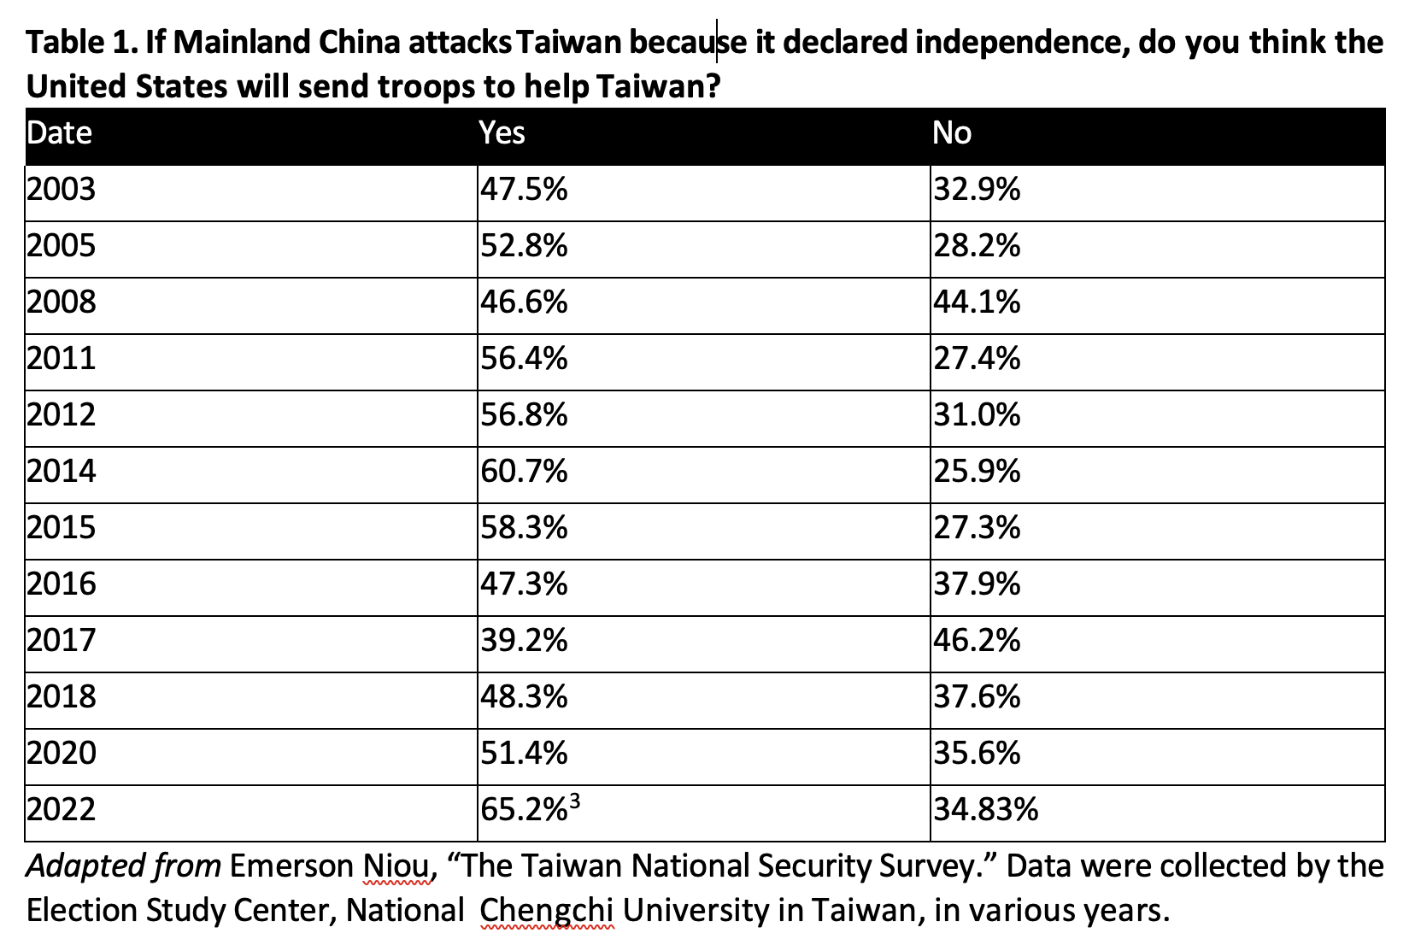
Strategic Ambiguity and Confident in US Support

Slide 32
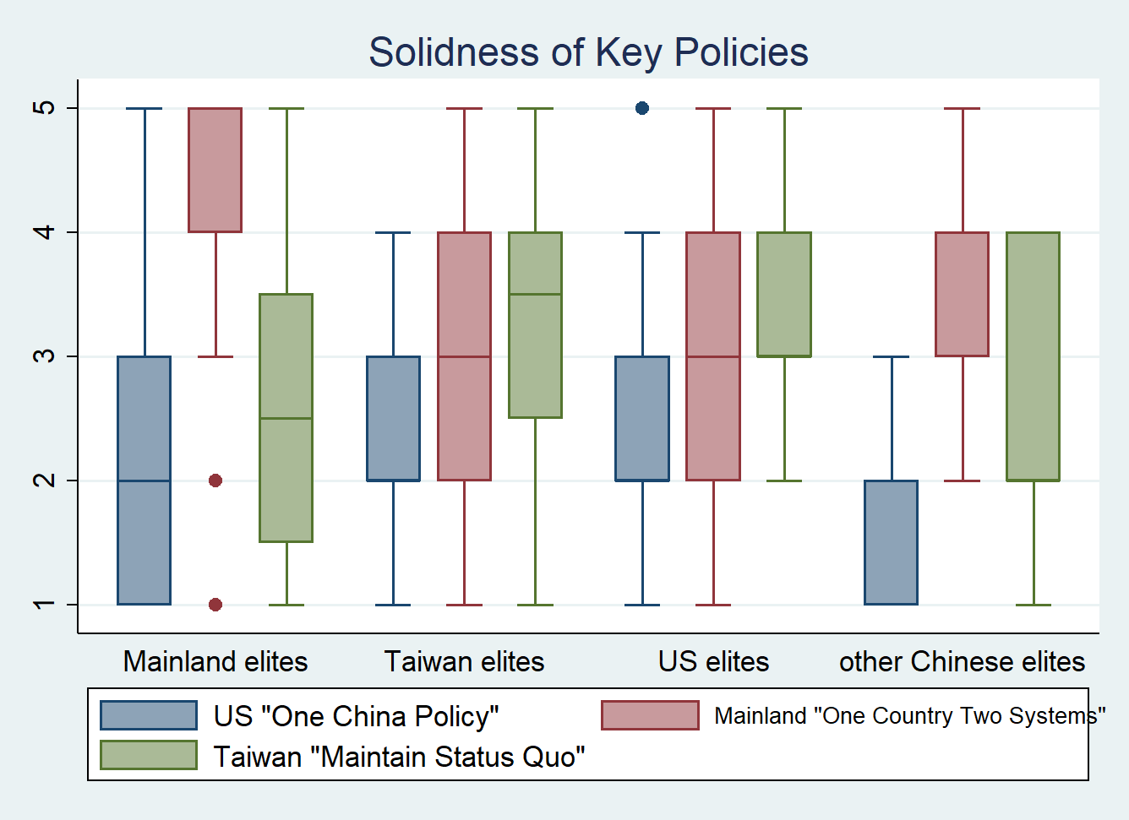
Perception of solidness of key policies

Slide 33
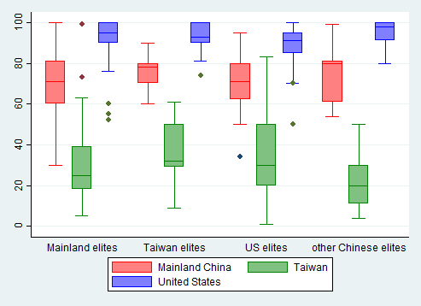
Perception of the military strength of the three sides

Slide 34
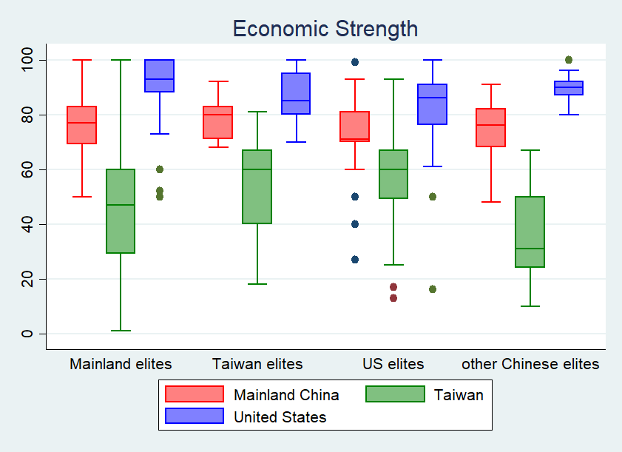
Perception of the Economic strength of the three sides

Slide 35
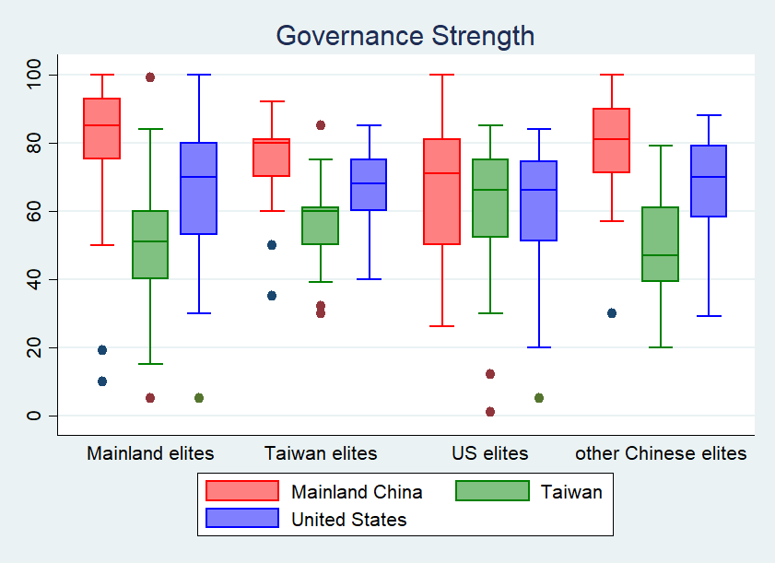
Perception of the Gov. strength of the three sides

Slide 36
Policy Implications
Divergent Perceptions Among Elites: Inconsistencies among elites and Impact on public opinion.
Combined Reassurance: The study suggests that effective reassurance strategy in power transitions requires actions (state capability measure) and statements that align, supported by transparent channels.
Reassurance is not playing nice: Reassurance strategy goes beyond displaying a benign attitude; it involves establishing a mutually acceptable baseline among all parties.

Slide 37

Policy Implications
The Dilemma:
Democratic elites are bound by the need to persuade voters, contrasting with non-democratic elites who can unilaterally direct policy.
The Solution:
If elites in leading democracies can reconcile elite and public views, it could set a precedent for allied elites to follow suit in reassurance strategies.

Slide 38
Specific Policy Action: Clarification for Strategy Ambiguity!
A US consensus on Taiwan—whether for or against independence—should be clear and understandable to ensure alignment among the public and allies.
To maintain the status quo, the US must unambiguously reassure its stance against both Taiwan independence and forceful unification.
All parties involved need to diminish mistrust and balance reassurances between China, the US, and Taiwan amid current tensions.
Develop a communication framework engaging all parties is vital for preserving peace and stability in the Taiwan Strait

Slide 39
Thank you!

